Slide 1

Analyzing and Predicting Motor Vehicle Collisions in New York City
Team G
Rohith KumarKoutike
Naveen Chowdary Nayudu
Pruthvi Reddy

Slide 2

Introduction to the Project
Focus on vehicular collisions in NYC.
Examines dataset containing details on date, time, location, contributing factors, and consequences of collisions.
Importance of the analysis for enhancing road safety and optimizing traffic management.

Slide 3
Research Questions
1. What are the temporal trends in vehicular collisions over the specified period?
2. Which boroughs or zip codes exhibit the highest frequency of collisions?
3. Are there specific times of the day when collisions are more likely to occur?
4. What is the distribution of injuries and fatalities among persons, pedestrians, cyclists, and motor vehicle occupants?
5. What are the most common contributing factors to vehicular collisions?
6. Which types of vehicles are most frequently involved in collisions?

Slide 4
Dataset Overview
Dataset: Motor Vehicle Collisions - Crashes
Link: [NYC Open Data](https://data.cityofnewyork.us/Public-Safety/Motor-Vehicle-Collisions-Crashes/h9gi-nx95/about_data)
Description:
- Data Size: (423 mb)
- Shape : (2094658 , 29)
Target Variable : NUMBER OF PERSONS KILLED

Slide 5
Type of Analysis
Analyses:
- Exploratory Data Analysis (EDA)
- Classification: Severity of collisions (e.g., minor, serious, fatal)
- Prediction: Likelihood of collisions at specific locations

Slide 6
Exploratory Data Analysis (EDA)
Goals:
- Identify trends and patterns in collision data.
- Example analyses: peak hours, high-risk locations.
Sample Visualizations:
- (Insert bar plots, pie charts, etc. relevant to EDA)

Slide 7
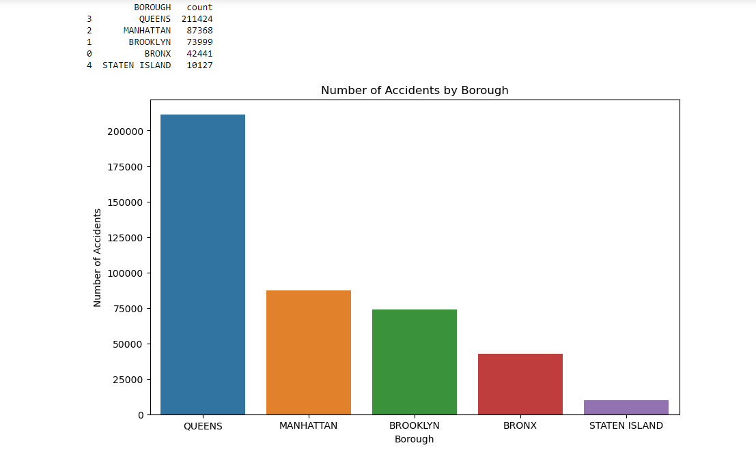
Number of Accidents by Borough
BOROUGH: Borough where the crash occurred

Slide 8
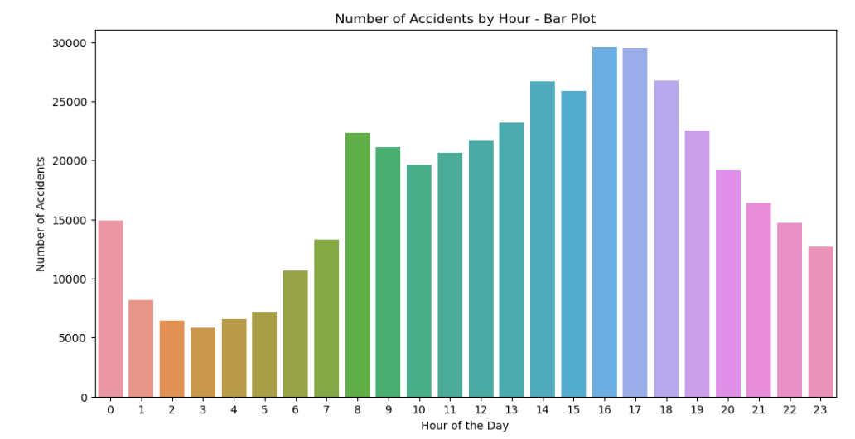
Number of accidents by hours in a day

Slide 9
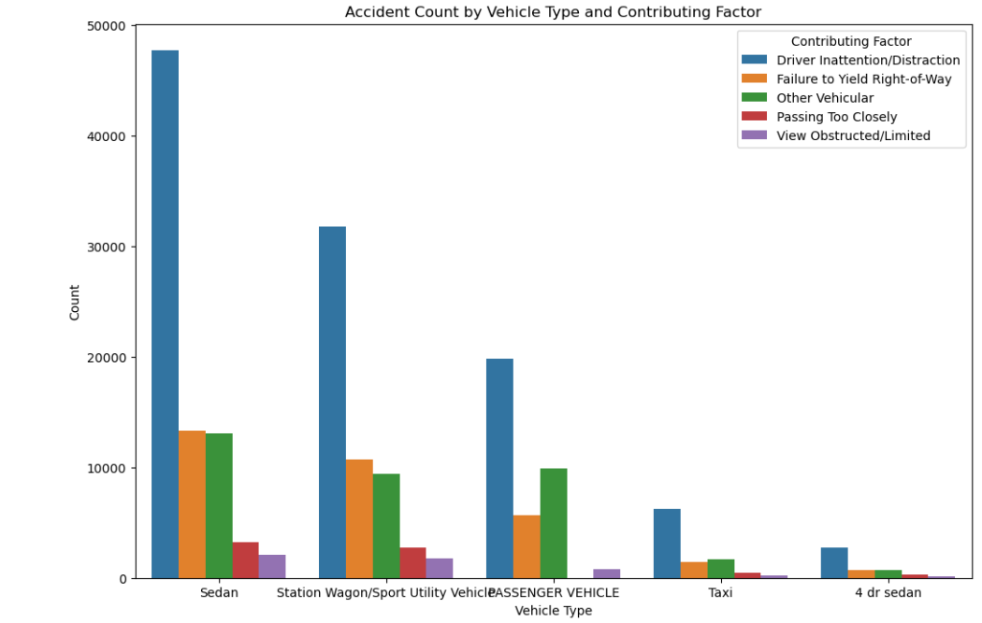
Accident Count by Vehicle Type and Contributing Factor

Slide 10
Machine Learning Techniques
Classification:
- Methods: Decision Trees, Random Forests
- Categories: Minor, Serious, Fatal
Prediction:
- Methods: Logistic Regression, Neural Networks

Slide 11
Performance Metrics
Classification Metrics:
- Accuracy, Precision, Recall, F1 Score
Prediction Metrics:
- Mean Absolute Error (MAE), Root Mean Squared Error (RMSE), Area Under the Curve (AUC) for ROC

Slide 12

Literature Review
Summary of Previous Work:
Bayesian Network Models
Study Reference: Wu et al. (2019)
Methodology Overview: Use of Bayesian Network models enhanced by feature selection via Random Forests.
Key Findings: Emphasize the real-time prediction capabilities and the importance of accurate feature selection.

Slide 13

2.Deep Learning Approaches
Study Reference: Ren et al. (2018)
Methodology Overview: Application of deep learning techniques integrating spatiotemporal data.
Key Findings: Improved prediction accuracy, showcasing the model's ability to handle complex urban data sets.
3. Comparative Analysis of Methodologies
Discussion: Compare and contrast the different techniques used across the studies.
Visualization: Use a table or chart to summarize and visually compare the methodologies and their effectiveness.

Slide 14
Thank you

